Slide 2
What is Punch Out?
Functionality implemented with the Core 9.2 Upgrade
Allows a requestor to connect directly to an on-line, negotiated
Supplier catalog, add items to a shopping cart and process
(purchase to pay) through Core-CT.

Slide 3
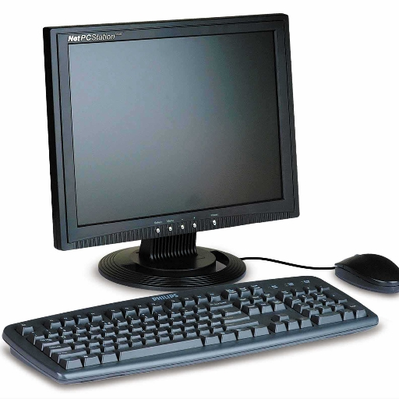
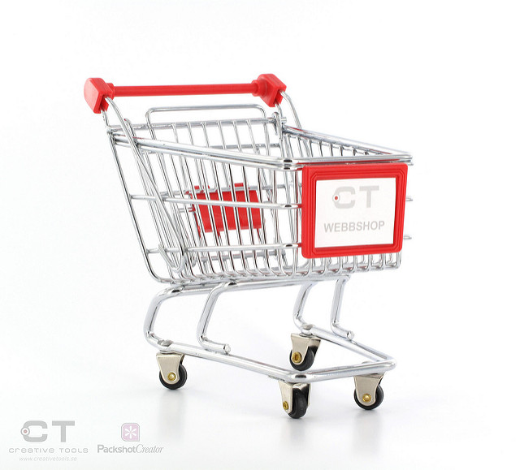
Core-CT
Vendor Website Catalog
Select Items to Shopping Cart
Items brought back to Core-CT for processing

Slide 4
Eliminates need to maintain catalog items
Better product information (pictures!)
Simplified business process (purchase to pay)

Slide 5
OFFICE
SUPPLIES
NEW &
IMPROVED
“PILOT”
PROGRAM
Create Order
Budget Check
Approval
Payment

